Slide 1
COSE472(00): Information Retrieval (정보검색) Lecture 0. Course Overview
Instructor: Jaegul Choo (주재걸)
jchoo@korea.ac.kr

Slide 2
About Me Google ‘Jaegul Choo’
Assistant Professor at Computer Science dept. in Korea Univ., starting from today (3/2/2015).
B.S. (2001) in Electrical Engineering at SNU
M.S. (2009) and Ph.D (2013) at Georgia Tech
Main Research
Main Expertise: Dimension Reduction and Clustering
Published >35 research articles (>220 citations)
Visual Analytics
Data Mining
Visualization
+

Slide 3
Basic Course Information
Time and Location
Monday 12pm-2pm, Wednesday 1-2pm
Room #202, Woojeong Information and Communications Building (정보통신관 202)
Instructor: Jaegul Choo (주재걸), Ph.D
Office: Room# 510A, Science Library Building (과학도서관 510A)
Phone / Email: 02-3290-4602 / jchoo@korea.ac.kr
Office Hours: Monday/Tuesday 2:00-3:00pm
Course Website:
We will use blackboard (https://kulms.korea.ac.kr/).
(All the class materials including the slides and homework assignments will be available here.)
Notes:
Can be viewed as a table.

Slide 4
What is this course about?
This course will introduce
Techniques related to web search and text mining
Application-oriented computational methods
This course will provide
Background for research in web search and text mining
Opportunities to learn up-to-date algorithms and practice
Notes:
Can be viewed as a table.

Slide 5
Textbooks
Main:
Introduction to Information Retrieval
Available online at http://www-nlp.stanford.edu/IR-book/
Recommended:
Search Engines : Information Retrieval in Practice
Available online at http://ciir.cs.umass.edu/irbook/
This course will be based on
Prof. Haechang Rim’s previous classes
http://www.cc.gatech.edu/~yzhen/cse6240spr15.html
http://web.stanford.edu/class/cs276/
Notes:
Can be viewed as a table.

Slide 6
Course Topics
Web search
Recommender systems
Other text mining techniques and applications
Notes:
Can be viewed as a table.

Slide 7
Course Topics (I): Web Search
Web search
Background
Document preprocessing and indexing
Evaluation
Link analysis
Vector space model
Language model and topic modeling
…
Notes:
Can be viewed as a table.

Slide 8
Course Topics (II): Recommender System
Recommender systems
Background
Matrix factorization approaches
Cold-start problem
Local collaborative filtering
Hybrid approaches
…
Notes:
Can be viewed as a table.

Slide 9
Course Topics (III): Other Techniques and Applications
Text categorization
NaiveBayes, Gradient boosting
Visual analytics for document data
Dimension reduction: principal component analysis, multidimensional scaling, t-distributed stochastic embedding
Other techniques
Crawling (web.ppt)
Regular expression
Question-answering
Document summarization
Notes:
Can be viewed as a table.

Slide 10
Prerequisites
Algorithms and data structures
Linear algebra
Probability and statistics
Programming
Notes:
Can be viewed as a table.

Slide 11
Grading
25%: Homework assignments
Problem sets
Small programming tasks
15%: Mid-term exam
15%: Final exam
40%: Term project
5%: Class participation
Attendance: For each missed class, 0.5% point will be deducted.
Notes:
Can be viewed as a table.

Slide 12
Homework Assignments
Once every 2-3 weeks
Mathematical derivations and problem solving
Small programming tasks
Notes:
Can be viewed as a table.

Slide 13
Exams
1 Mid-term on 10/26 (Monday)
Note that we WILL have classes during mid-term exam week (10/19 and 10/21)
No class on 10/28
1 Final on 12/14 (Monday)
Schedule may slightly change.
These will be closed-book and in-class exams.
Absolutely no programming questions
Mainly based on understanding of the material
Notes:
Can be viewed as a table.

Slide 14
Term Project
Hands-on experience in practical information retrieval and text mining
Team size ≤ 3 persons
Project Categories
Theoretical analysis
Algorithm implementation
Application development
Project topics:
Students can choose topics on their own.
Otherwise, please contact the instructor for potential topics.
Surveys are not encouraged and some implementation is expected
Notes:
Can be viewed as a table.

Slide 15
Course Overview
Notes:
Can be viewed as a table.

Slide 16
Information Retrieval
Information Retrieval (IR) is finding material (usually documents) of an unstructured nature (usually text) that satisfies an information need from within large collections (usually stored on computers).
These days we frequently think first of web search, but there are many other cases:
E-mail search
Searching your laptop
Corporate knowledge bases
Legal information retrieval

Slide 17
IR System Architecture
Information Needs
Documents
Forming a query
Indexing
Query
Indexed documents
Search
Relevance feedback
Retrieved documents

Slide 18
What is a Document?
Examples:
web pages, email, books, news stories, scholarly papers, text messages, Word™, Powerpoint™, PDF, forum postings, patents, IM sessions, etc.
Common properties
Significant text content
Some structure (e.g., title, author, date for papers; subject, sender, destination for email)

Slide 19
Documents vs. Database Records
Database records (or tuples in relational databases) are typically made up of well-defined fields (or attributes)
e.g., bank records with account numbers, balances, names, addresses, social security numbers, dates of birth, etc.
Easy to compare fields with well-defined semantics to queries in order to find matches
Text is more difficult

Slide 20
Documents vs. Database Records
Example bank database query
Find records with balance > $50,000 in branches located in Amherst, MA.
Matches easily found by comparison with field values of records
Example search engine query
bank scandals in western mass
This text must be compared to the text of entire news stories

Slide 21
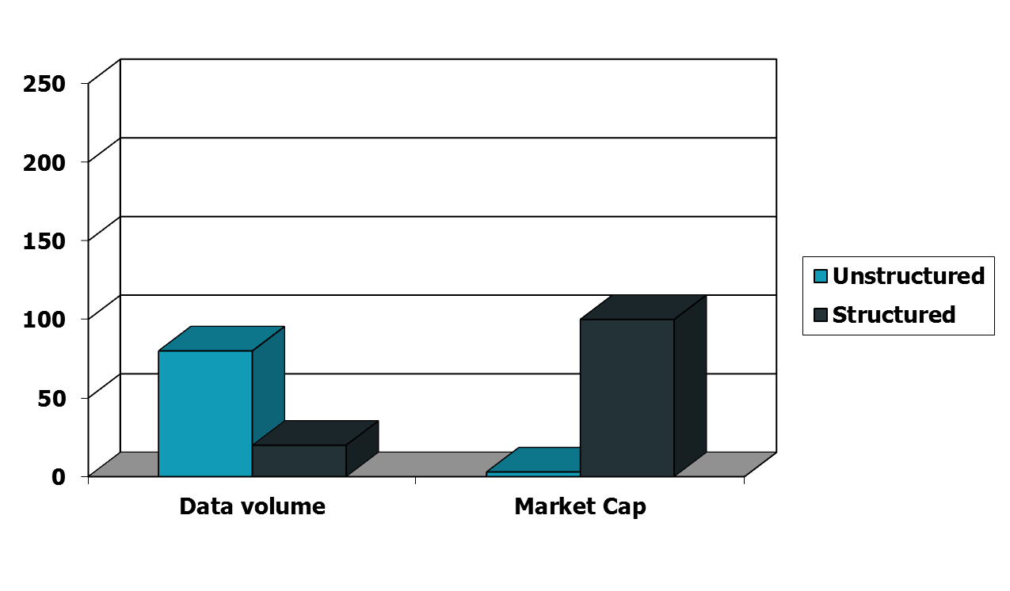
Unstructured (text) vs. structured (database) data in the mid-nineties

Slide 22
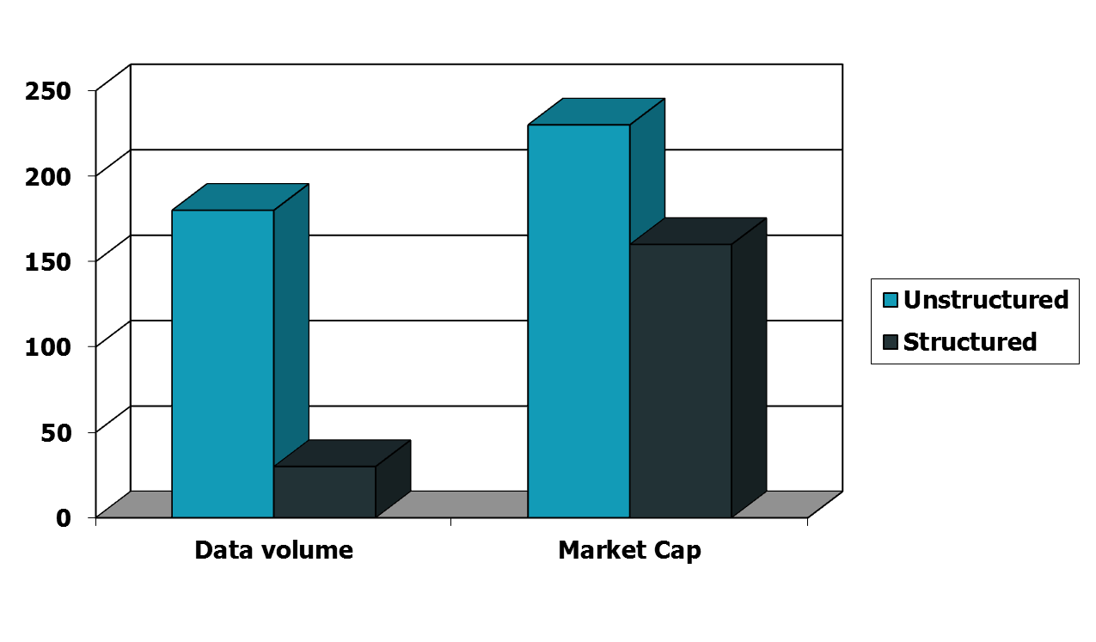
Unstructured (text) vs. structured (database) data today
Notes:
To the surprise of many, the search box has become the preferred method of information access.
Customers ask: Why can’t I search my database in the same way?

Slide 23
Comparing Text
Comparing the query text to the document text and determining what is a good match is the core issue of information retrieval
Exact matching of words is not enough
Many different ways to write the same thing in a “natural language” like English
e.g., does a news story containing the text “bank director in Amherst steals funds” match the query?
Some stories will be better matches than others

Slide 24
Dimensions of IR
IR is more than just text, and more than just web search
although these are central
People doing IR work with different media, different types of search applications, and different tasks

Slide 25
Other Media
New applications increasingly involve new media
e.g., video, photos, music, speech
Like text, content is difficult to describe and compare
text may be used to represent them (e.g. tags)
IR approaches to search and evaluation are appropriate

Slide 26
Dimensions of IR
Content | Applications | Tasks
Text | Web search | Ad hoc search
Images | Vertical search | Filtering
Video | Enterprise search | Classification
Scanned docs | Desktop search | Question answering
Audio | Forum search
Music | P2P search
 | Literature search

Slide 27
IR Tasks
Ad-hoc search
Find relevant documents for an arbitrary text query
Filtering
Identify relevant user profiles for a new document
Classification
Identify relevant labels for documents
Question answering
Give a specific answer to a question

Slide 28
Big Issues in IR
Relevance
What is it?
Simple (and simplistic) definition: A relevant document contains the information that a person was looking for when they submitted a query to the search engine
Many factors influence a person’s decision about what is relevant: e.g., task, context, novelty, style
Topical relevance (same topic) vs. user relevance (everything else)

Slide 29
Big Issues in IR
Relevance
Retrieval models define a view of relevance
Ranking algorithms used in search engines are based on retrieval models
Most models describe statistical properties of text rather than linguistic
i.e. counting simple text features such as words instead of parsing and analyzing the sentences
Statistical approach to text processing started with Luhn in the 50s
Linguistic features can be part of a statistical model

Slide 30
Big Issues in IR
Evaluation
Experimental procedures and measures for comparing system output with user expectations
Originated in Cranfield experiments in the 60s
IR evaluation methods now used in many fields
Typically use test collection of documents, queries, and relevance judgments
Most commonly used are TREC collections
Recall and precision are two examples of effectiveness measures

Slide 31
Big Issues in IR
Users and Information Needs
Search evaluation is user-centered
Keyword queries are often poor descriptions of actual information needs
Interaction and context are important for understanding user intent
Query refinement techniques such as query expansion, query suggestion, relevance feedback improve ranking

Slide 32
IR and Search Engines
A search engine is the practical application of information retrieval techniques to large scale text collections
Web search engines are best-known examples, but many others
Open source search engines are important for research and development
e.g., Lucene, Lemur/Indri, Galago
Big issues include main IR issues but also some others

Slide 33
IR and Search Engines
Information Retrieval
Search Engines
Performance
-Efficient search and indexing
Incorporating new data
-Coverage and freshness
Scalability
-Growing with data and users
Adaptability
-Tuning for applications
Specific problems
-e.g. Spam
Relevance
-Effective ranking
Evaluation
-Testing and measuring
Information needs
-User interaction

Slide 34
Search Engine Issues
Performance
Measuring and improving the efficiency of search
e.g., reducing response time, increasing query throughput, increasing indexing speed
Indexes are data structures designed to improve search efficiency
designing and implementing them are major issues for search engines

Slide 35
Search Engine Issues
Dynamic data
The “collection” for most real applications is constantly changing in terms of updates, additions, deletions
e.g., web pages
Acquiring or “crawling” the documents is a major task
Typical measures are coverage (how much has been indexed) and freshness (how recently was it indexed)
Updating the indexes while processing queries is also a design issue

Slide 36
Search Engine Issues
Scalability
Making everything work with millions of users every day, and many terabytes of documents
Distributed processing is essential
Adaptability
Changing and tuning search engine components such as ranking algorithm, indexing strategy, interface for different applications

Slide 37
Spam
For Web search, spam in all its forms is one of the major issues
Affects the efficiency of search engines and, more seriously, the effectiveness of the results
Many types of spam
e.g. spamdexing or term spam, link spam, “optimization”
New subfield called adversarial IR, since spammers are “adversaries” with different goals

Slide 38
Course Goals
To help you understand search engines, evaluate and compare them, and modify them for specific applications
Provide broad coverage of the important issues in information retrieval and search engines
includes underlying models and current research directions

Slide 39
Conferences
ACM SIGIR: Association of Computing Machinery Special Interest Group on Information Retrieval
CIKM: Conference on Information and Knowledge Management
WSDM: Web Search and Data Mining Conference
WWW: World Wide Web Conference
HLT: Human Language Technologies
ACL: Association for Computational Linguistics
ECIR: European Conference on Information Retrieval
AIRS: Asian Information Retrieval Symposium

